Slide 1
Skull Stripping of MRI image of brain using ANTSpy

Slide 2
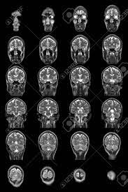
MRI Images
What It Is?
Magnetic resonance imaging (MRI) of the brain is a safe and painless test that uses a magnetic field and radio waves to produce detailed images of the brain and the brain stem. An MRI differs from a CAT scan (also called a CT scan or a computed axial tomography scan) because it does not use radiation.

Slide 3
Skull stripping
A process of removing the skull portion from the brain. Such that
It is crucial as the models that brain tumor segmentation are trained on BRATs dataset(which is actually skull stripped).
BRATs dataset is a labeled dataset which is openly available that is used for model training.
So the skull portion decreases the accuracy of such models(noise).

Slide 4

Methodoly:
I used the atlas of brain that is readily available online.
The Atlas was of T1 modality(with skull and its mask) of MRI which has the highest intensity.
Using the antspy registration fuction in which this atlas served as a moving image and my raw MRI image served as a fixed image.The moving image gets mapped over the fixed image and the resultant transformation matrice is obtained.
This transformation matrice was then used to change the atlas mask accordingly the same way as T1 atlas is changed.

Slide 5
Raw MRI Image and Mask
Output:
RAW MRI
Stripped Result

Slide 6
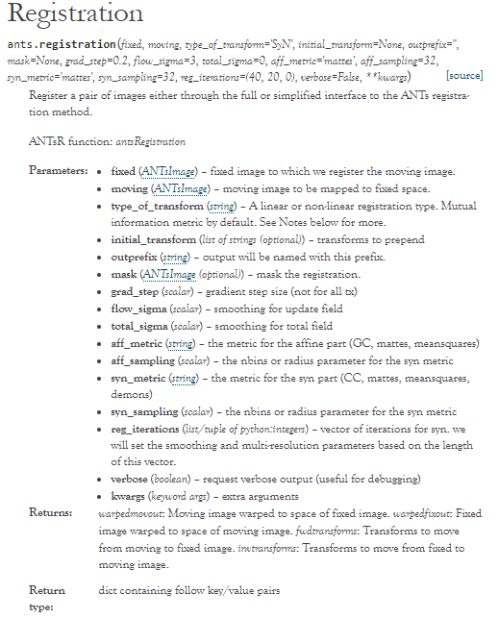

Slide 7
